Slide 1
CYBER MEDIA RESEARCH & SERVICES LIMITED
A DIGITAL MARKETING TECHNOLOGY COMPANY
www.cmrsl.net

Slide 2
Digital Marketing Industry Growth Remains Strong
The future of Digital Advertising continues to grow at a steady pace. As AI takes center-stage marketing technologies will drive the next phase of growth. Data will continue to be an essential component that drives marketing success.
CMRSL’s technology offers Programmatic Solutions, Media Buying and Data Analytics to a global customers base.
$800.00
$835.82
$765.98
$600.00
$695.96
$626.86
Billions
$400.00
$567.49
$200.00
$0.00
2022
2023
2024
2025
2026
Digital Media Spend
Digital will continue to be a key driver of the Indian ad market with 32% growth and 40% share of ad spends in 2023. It is forecasted to overtake television spending for the first time
Source: eMarketer
www.cmrsl.net

Slide 3
Programmatic:
New Ad Money
2020
37%
India Programmatic Market in 2022 was 42% of overall Digital Spends.
Global Programmatic Advertising Market Surges to $8.87 Billion in 2023, Expected to Reach $19.12 Billion by 2027. Programmatic transactions is already a mainstay and with further innovation continues to expand into AR, Connected TV and DOOH.
Programmatic is growing rapidly, with spending predicted to reach $558 million by 2023.
Today, programmatic ad spend accounts for over 80% of all digital marketing budgets globally
Connected TV, DOOH, AI automation all point towards long-term Programmatic growth
2020
86.3%
US Programmatic Market in 2022 was 87.5% of overall Digital Spends
Source: eMarketer
www.cmrsl.net
Notes:
Please search and get the exact data.

Slide 4
CMRSL VISION 2025

Slide 5
Vision 2025
Establish among the largest digital marketing agencies in India
Build a moat by becoming a centralized data, products and service provider for stakeholders across the ecosystem
Enhance value creation between advertisers & publishers. Be a technology enabler (focus on AI enablement) with multiple revenue streams
CMRSL Offerings
Big Data
Programmatic Targeting
Data Analytics & Consulting
Advertisers (demand)
AI enabled Media Buying
End-to-end Ad Operation
Publishers (supply)
eCommerce Automation
Driving Traffic Arbitrage
www.cmrsl.net

Slide 6
Our Key Strengths – An Ecosystem Play
CyberMedia is a Recognized Brand
International Focus
Presence across International Markets out of Singapore
CyberMedia known across the advertising community
Programmatic Sweet-spot
Machine Learning + AI
Our presence with advertisers and publishers offers multiple opportunity in Programmatic. CMRSL tech to drive this growth
Technology Driven marketing decisions. Managing data across 250 mn+ users across many industries
CMRSL
Data Fueled Growth
CMGalaxy SaaS
Strong Track Record and Expertise in Data Analytics and Market Insights & Research
SaaS offerings to Brands gaining strong interest
www.cmrsl.net

Slide 7
Tenets for Future Growth
First party data: Valuable insights directly from our own customers, driving personalized experiences and informed decision-making
AI automation in MarTech streamlines processes, increases automation, and improves the efficiency and effectiveness of online advertising
Establish Global Partnerships that help scale up business
Create digital arbitrage opportunities that can be managed at scale
www.cmrsl.net

Slide 8
Our Technology Philosophy
Meaningful Marketing
Accurate Marketing
Automated Marketing
CMRSL products simplifies marketing for brands & publishers
Our modern, scalable marketing solutions are aligned directly with customer success
www.cmrsl.net

Slide 9
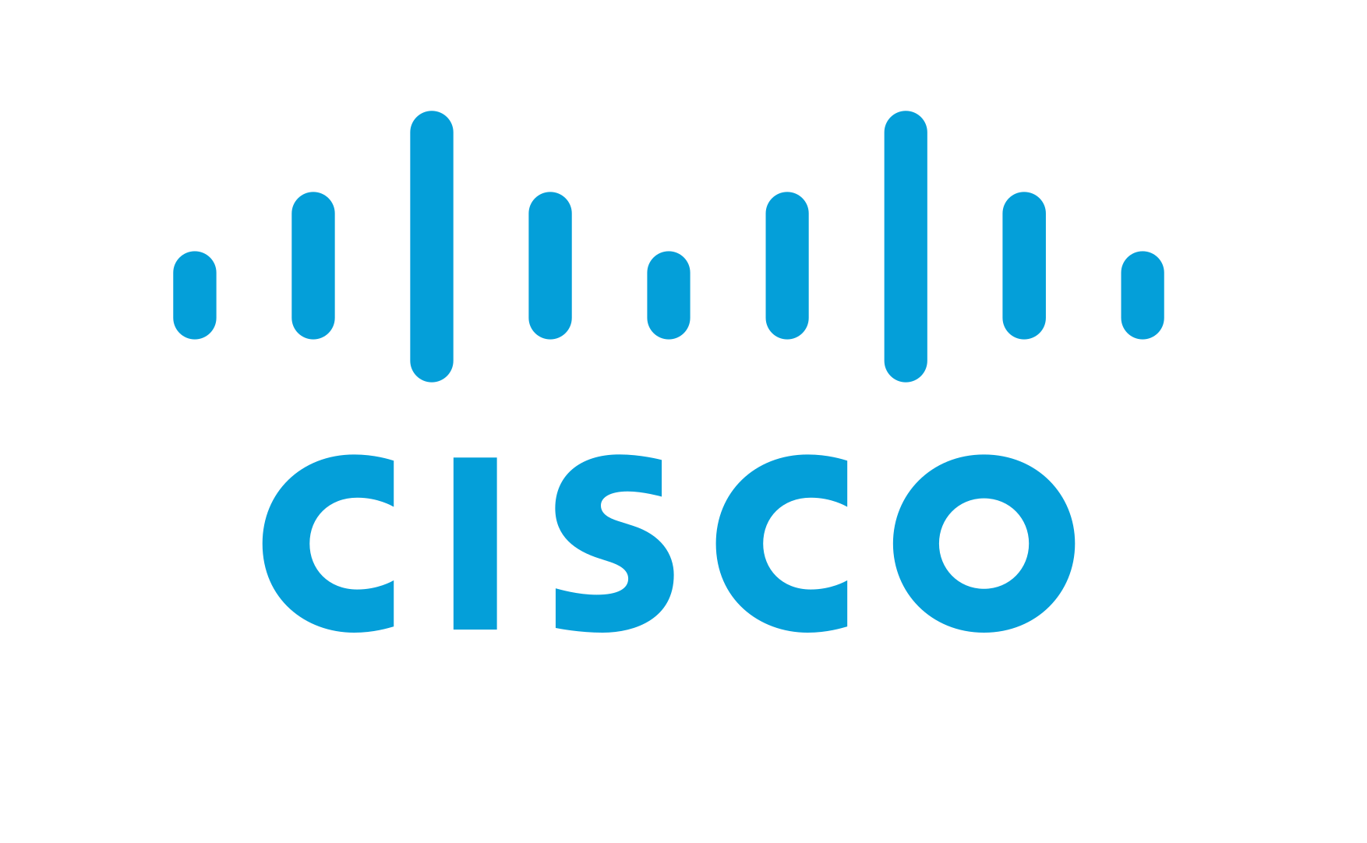
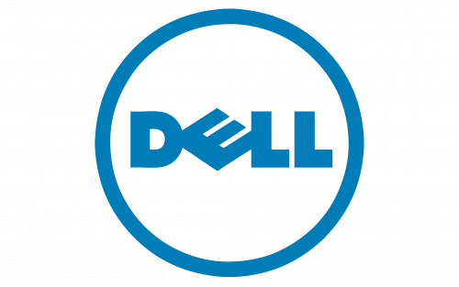
Select Key Clients
www.cmrsl.net

Slide 10
CONTACTS
THANK YOU.
Investor.care@cmrsl.net
enquiry@cmrsl.net
www.cmrsl.net

